Slide 1
Proposal Presentation
Smart Emergency
By
Putchakarn Jaikon
Sawatdiporn Kitirot

Slide 2
Travel
Everyone has to travel
  working
  studying
  shopping
  holiday to visiting people
Everybody wishes a safe travel
However …
“ the problems or unexpected events can happen every time ”

Slide 3

The problem occurred
The unexpected events
  car accident
  miscarriage
  the car ran out of fuel
The people may need to find and go to the closest help location
But !!
Do not know the current location
Do not know where the nearest and direction to go the help place
Hard to find help locations and their contact information
Waste time if miscarry and go the wrong direction away from the closest help place

Slide 4


Usual ways to solve the problem
Call to a help center
Use an online map application
But !!
The help center do not know the exact location (e.g. Bug1113)
  Receive the information that is not accurate enough
Online map can not use without internet connection
○ Such as Nostra map, Google maps

Slide 5

Smart Emergency
Application on a mobile device
Runs on Android OS
Provides the contact information or phone numbers of the nearest help location
Provides a map
Offline mode in case of lost internet connection
  collects name, contract number, address
  update collected data automatically

Slide 6
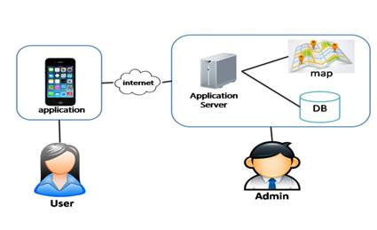
System Architecture of Smart Emergency
Mobile part for the user
Server part for the admin
The user uses the application and internet to connect with the application server
The admin manages the the help data and updates the data to the application server

Slide 7
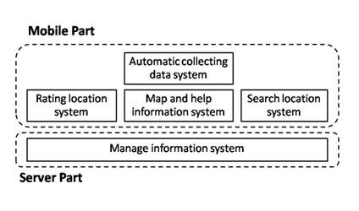
System Architecture of Smart Emergency
Mobile Part
  Feature 1: Map and help information system
  Feature 2: Search information system
  Feature 3: Rating location system
  Feature 4: Automatic collecting data system
Server part
  Feature 5: Manage information system

Slide 8
Technology & Tools

Slide 9
• Eclipse
- Open Source
- Supported with many operating systems
(Windows, Linux, Mac OS)
- Supported Android Development Tools

Slide 10
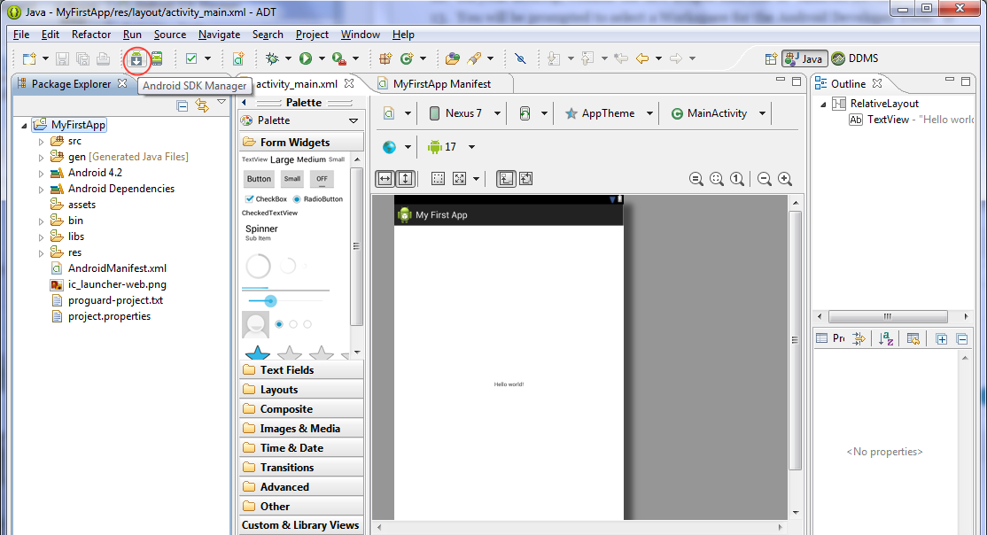
Android Development Tools
• Android Development Tools
- Plug-in for Eclipse
- Supported Eclipse to build android application.

Slide 11
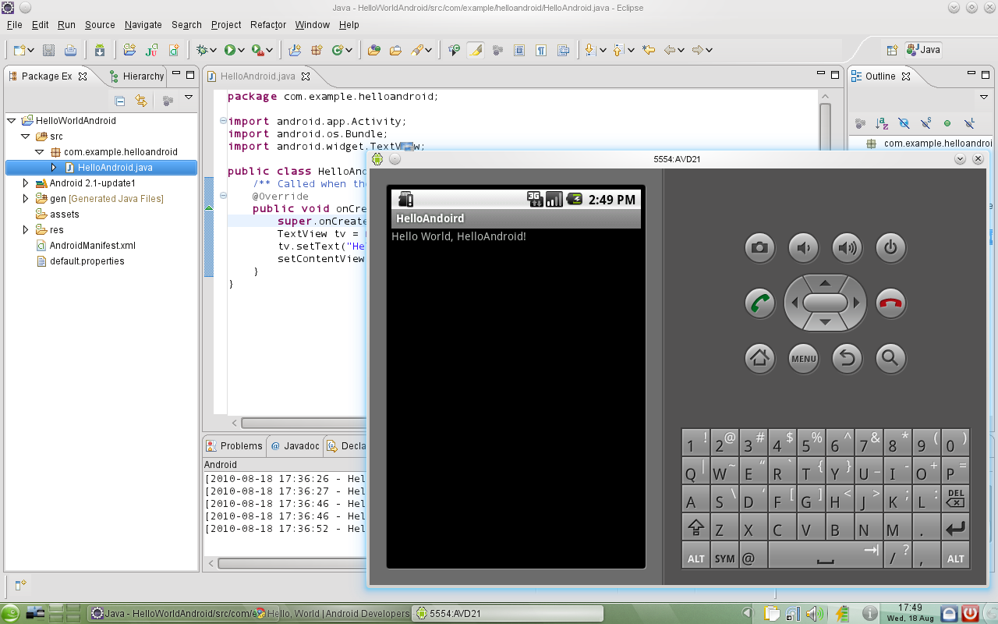
• Android SDK
- provides mobile device emulator
- Supported Eclipse to build android application.

Slide 12

• MySQL
- Open Source
- Supported with many operating systems
(Windows, Linux, Mac OS)
- Management Ease
(quick-start capability, automatic space expansion)

Slide 13
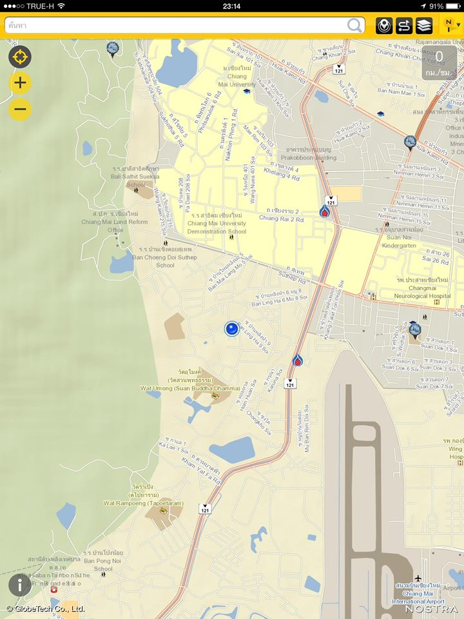
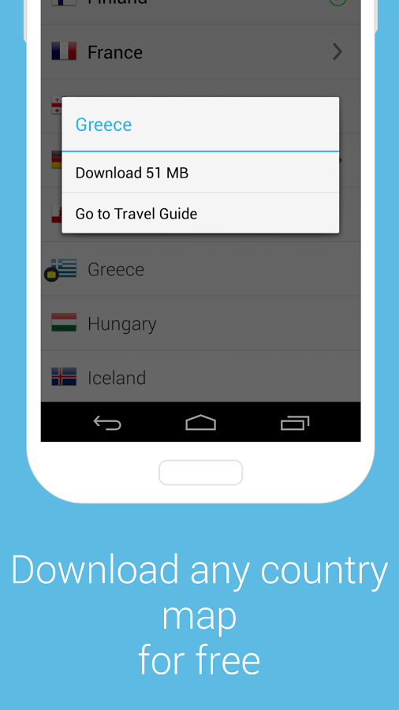
• MapsWithMe API
- Supports offline map for all countries.
- Works on Android device
- Open Source

Slide 14
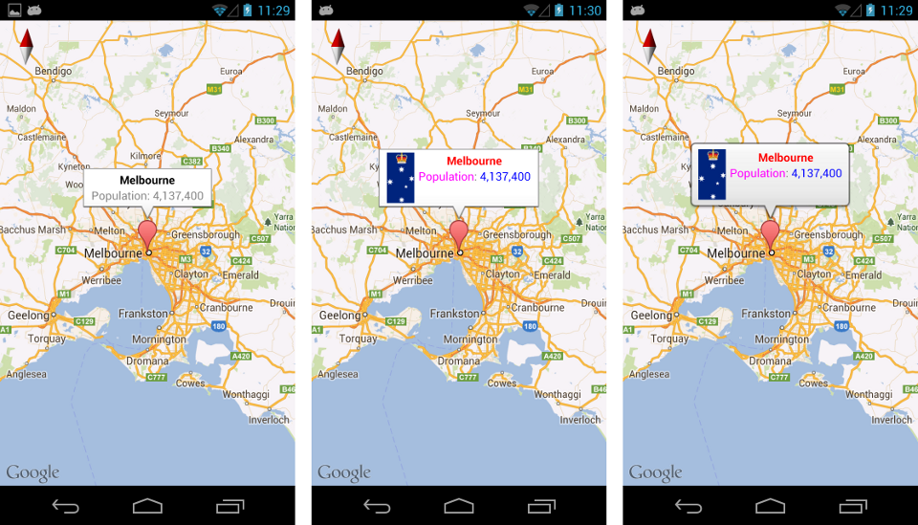
• Google Maps Android API
- Supports calculating distance between locations
- Working with Android SDK
- Providing longitude and latitude.

Slide 15


Google Map and MapWithMe
Online
Offline
- Provide online map
- Provide offline map

Slide 16
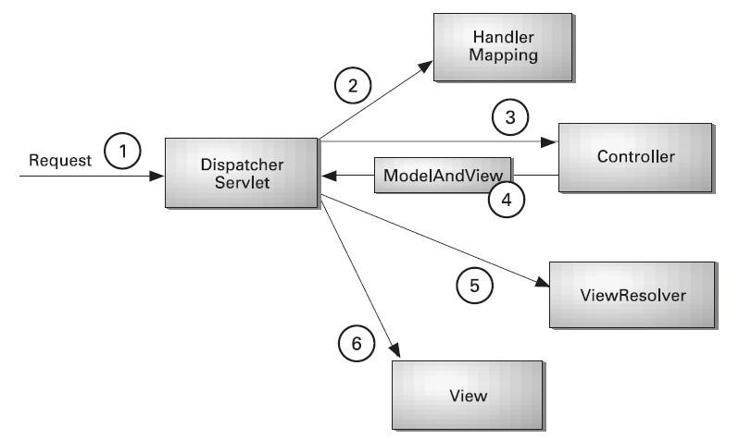
• Spring MVC
- Management support Handle Exception
- Spring MVC is very Adaptability, non-intrusiveness, and flexibility.

Slide 17
Schedule & Milestone

Slide 18
Schedule & Milestone
Milestone | Task | Milestone Criteria | Planned date
1 | Proposal | Topic defined | February
2 | Proposal | - Proposal reviewed - Proposal submitted - Proposal presentation | March
3 | Progress Report I | - Software requirement specification - Feature 1 and Feature 5 - Feature designed - Test planned - Feature implemented - Feature tested - Progress report submitted - Progress report presentation | May
4 | Progress Report II | - Feature 2 and Feature 4 - Feature designed - Test planned - Feature implemented - Feature tested - Progress report submitted - Progress report presentation | July
5 | Progress Report III | - Feature 3 - Feature designed - Test planned - Feature implemented - Feature tested - Progress report submitted - Progress report presentation | October
Feature 1: Map and help information system
Feature 2: Search information system
Feature 3: Rating location system
Feature 4: Automatic collecting data system
Feature 5: Manage information system

Slide 19
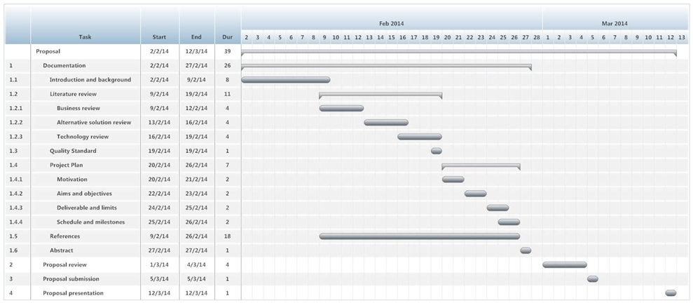
Schedule & Milestone
Proposal

Slide 20
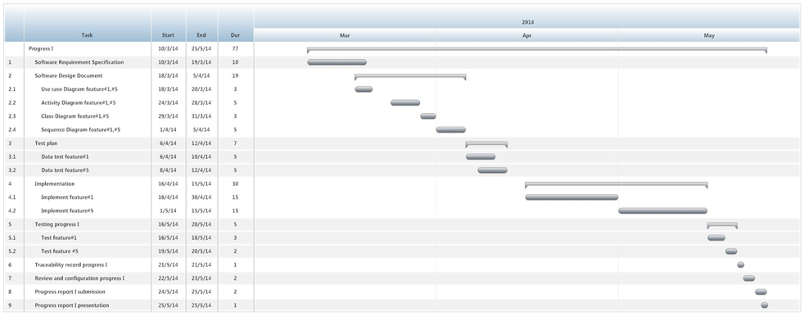
Schedule & Milestone
Progress Report I

Slide 21
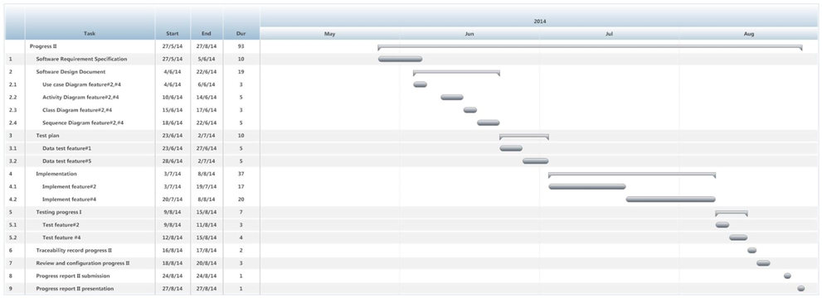
Schedule & Milestone
Progress Report II

Slide 22
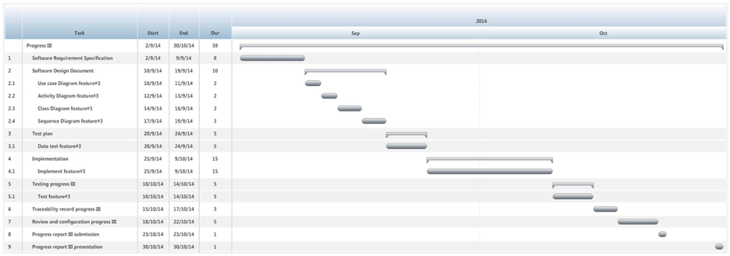
Schedule & Milestone
Progress Report III

Slide 23
Q/A
Thank you

